Slide 2
Although taxes may be burdensome, they also make government possible.
Without taxes, there could be no public institutions—no legislature, courts, or system of law enforcement.
Taxation was the main issue that sparked the American Revolution.

Slide 3
The Tax Equity Debate: Who Should Pay and Why?
One of the most hotly debated issues is the principle of tax equity, the idea that the tax system should be fair.
The crucial issue in the tax equity debate is who should pay.

Slide 4
Economists offer two basic approaches to this problem:
The ability-to-pay principle
Says that citizens should be taxed according to their income or wealth.
People with higher incomes should pay more tax.
People with lower incomes should pay less tax.
Federal and state income taxes are based on this principle.
For example, a lawyer who earns $200,000 a year pays a higher percentage of income in taxes than does a teacher who earns $50,000 a year.

Slide 5
Economists offer two basic approaches to this problem:
The benefits-received principle says that those who benefit from a particular government program should pay for it.
For example, people who drive should pay for the upkeep of the highway system.
Gasoline taxes that fund road repairs are based on this principle, as are highway and bridge tolls.
A driver deposits coins into a parking meter.

Slide 6
Taxes and Efficiency: Deadweight Losses and the Costs of Compliance
A deadweight loss occurs when the cost to consumers and producers from a tax—due to lost productivity or sales—is larger than the size of the tax revenue it generates. As economics writer Charles Wheelan put it, a deadweight loss “makes you worse off without making anyone else better off.”
Another source of tax inefficiency is the cost of complying with the tax code.
Every year, U.S. taxpayers spend many hours, and often hundreds of dollars, preparing their income tax forms.
The time and money spent on tax preparation are resources that, if we had a more efficient tax system, could be used productively in other ways

Slide 7
What Kinds of Taxes Will You Pay in Your Lifetime?
The tax base is the thing that is taxed, such as personal income, a good sold at a store, or a piece of property. Taxes are defined according to their tax base. For example, income tax is based on personal income. A property tax is based on the value of property, such as a home.
The tax rate is the percentage of income—or of the value of a good, service, or asset—that is paid in tax. For example, if the income tax rate were set at 20 percent, taxpayers would have to pay an amount equal to 20 percent of their taxable income.

Slide 8
Tax Structures: Proportional, Progressive, and Regressive
A proportional tax is a tax that takes the same share of income at all income levels. For example, a proportional income tax of 10 percent would tax all incomes at that rate.
A progressive tax is a tax that takes a larger share of income as income increases. A progressive tax is based on the ability-to-pay principle. Most federal taxes, including the federal income tax, are progressive.
The third tax structure, the regressive tax, is a tax that takes a smaller share of income as income increases. Governments do not set out to impose higher tax rates as incomes fall.
Example: Sales tax

Slide 9
Individual Income Taxes
The largest share of tax revenue taken in by the federal government comes from individual income taxes
Applies to all U.S. citizens and residents with income above a certain minimum level.
The IRS collects taxes from workers using a “pay as you earn” system.
Under this system, also known as withholding, employers take out a certain amount of tax from each paycheck.
At the beginning of each year, most workers receive a W-2 form, which lists their wages for the previous year and the amount of tax that was withheld.

Slide 10
Payroll Taxes
The second-largest share of federal tax revenue comes from payroll taxes.
A payroll tax is a tax on the wages a company pays its employees. Of the several kinds of payroll taxes, the two most important are the Social Security tax and the Medicare tax. Both are used to fund large federal social insurance programs.
The Social Security tax is set at a fixed rate, which is paid half by the employer and half by the employee. People who are self-employed pay the entire tax themselves. In 2008, the total Social Security tax rate was 12.4 percent.
This is a regressive tax

Slide 11
Property taxes
Taxes on property are a major source of revenue for many state and local governments. Property taxes are commonly levied on real property, which consists of land and buildings.

Slide 12
Sales tax
Another important source of state and local revenue is the sales tax. Such a tax levies a percent charge on the purchase of a wide variety of goods and services, from manufactured items to meals served in restaurants.

Slide 13
Corporate Income Tax
The largest business tax is the federal corporate income tax, which is applied to the profits of corporations.
Like individual income taxes, corporate taxes are progressive,

Slide 14
Excise and Luxury Taxes
Excise taxes are typically levied on goods and services a government wants to regulate. For example, alcohol and cigarettes are taxed to discourage their use. Because of their association with alcohol and cigarettes, excise taxes are sometimes called sin taxes. Like other sales taxes, excise taxes are generally regressive.
Luxury taxes, as the name implies, are levied on the sale of luxury goods, such as fur coats and private jets. Luxury taxes are progressive, because the consumption of luxury goods increases as income increases.

Slide 15
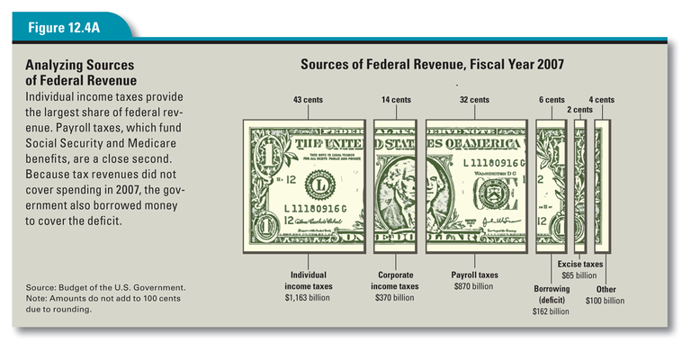
How Do U.S. Governments Spend the Revenue They Raise?

Slide 16
How Do U.S. Governments Spend the Revenue They Raise?
Even with these four major taxes, the government typically does not take in enough revenue to cover all its expenditures. This gives rise to the federal deficit, the shortfall between tax revenues and government expenditures in any given year.
To make up this difference, the government borrows money. Federal borrowing takes place through the sale of government bonds, which include Treasury bills, savings bonds, and other government-issued certificates of debt.

Slide 17
Spending by State and Local Governments
State and local governments typically generate revenue to pay for education, law enforcement, and fire protection services through property and sales taxes.

